Slide 1
Reproducible data analysis
Mark Ewing

Slide 2
Reproducible Data analysis
Reproducible
Someone else can take your data, your analysis flow and obtain your results
Important for science
Important for business
Important for quality
Replicatable
Someone else can take your hypothesis, gather their own data, perform their own analysis and arrive at the same conclusion
Important for science

Slide 3
The problem with Excel
No log of what steps were taken to arrive at an answer
If any iteration is required to obtain all results (adjusting filters, etc.) this can result in numbers that can’t be reproduced
Any number can just be typed into any cell – where’d it come from?
Not an uncommon problem

Slide 4
Why a programming language?
With a programming language, every step is explicitly listed
Can be commented to provide insight to each step
Code can be run on updated data with (usually) no extra effort
Programming languages are computer agnostic – what runs on your computer will run other other computers too
Often free, so there’s no need for them to own potentially expensive software

Slide 5
Introduction to R

Slide 6

What is R?
Free and open-source software
Free as in speech
Free as in beer
Statistical Programming Language
One of the most popular programming languages in the world

Slide 7

Why use Rstudio?
Integrated development environment
Syntax highlighting
Error warnings
Auto completion
Visual environments
Free as in beer*

Slide 8
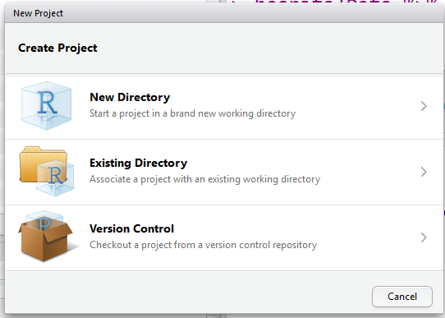
Projects in Rstudio
Projects help you keep everything organized
Critical to achieving reproducible analysis

Slide 9
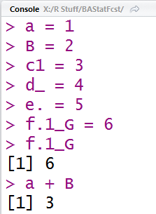
Variables in R
Must begin with a letter
May contain numbers, ‘_’ and ‘.’
Case sensitive
Use <- or = to assign names to values
Variables do not have a type
Functions and variables can have the same name – R will intuit which one you want based on how you use it

Slide 10
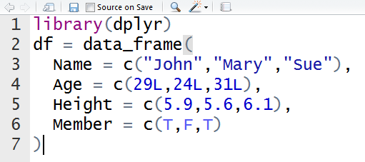
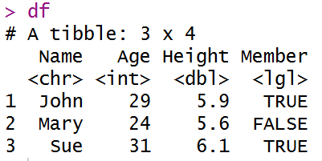
Data storage in R
Tables of data can be stored in data frames
Data frames have columns and rows
A column has only one type of data (numbers, letters, etc.)
Columns have names – rows do not

Slide 11
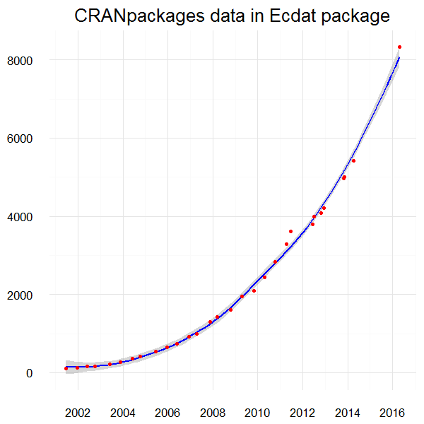
Libraries / Packages
Library means the same thing as Package as far as we’re concerned
Packages contain pre-built functions that make certain tasks easier in R
Sometimes they make R faster
Packages are built by volunteers
Packages are FOSS
Free as in beer
Free as in speech
install.packages(“packagename”)

Slide 12
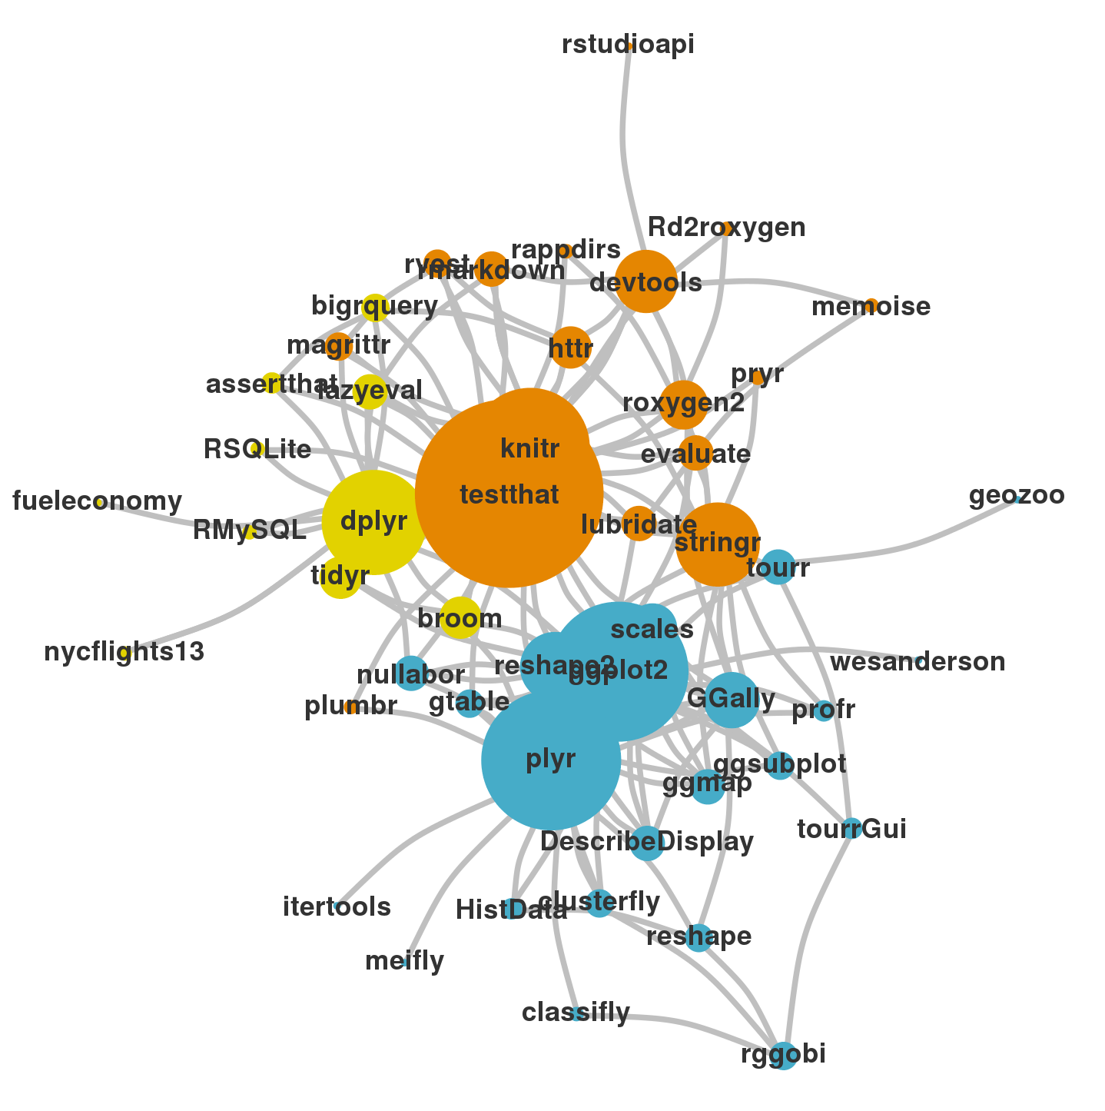
Hadleyverse
Hadley Wickham is a prolific package developer
Works for RStudio
His big focus is ease of data manipulation and visualization
His packages will be the focus of the workshop

Slide 13
Importing data to R

Slide 14
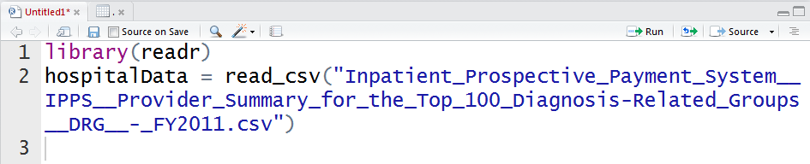
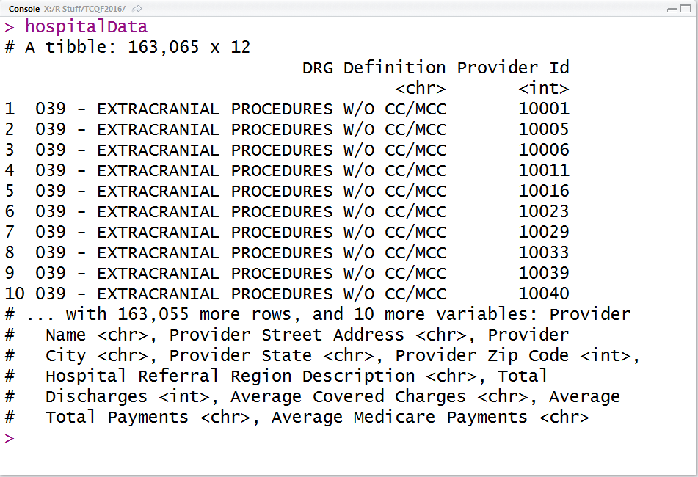
readr
Provides fast method for reading and writing in a variety of file types
read_csv
read_tsv
read_table
read_delim
Guesses at the type of data in each column but also provides the ability to specify column types
?read_csv

Slide 15

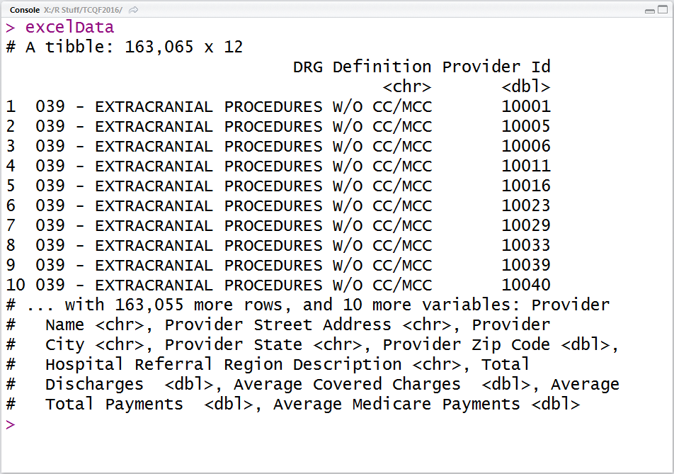
readxl
Provides function to read in .xls and .xlsx files
read_excel
Specify the column types or let the package guess
Specify the sheet by name or index
?read_excel

Slide 16
Managing data in R

Slide 17

Rene Magritte’s Contribution
The magic of pipes
%>%
Data %>% function()
Data is automatically passed into the first argument of the function
Makes code so much more readable

Slide 18

Rene Magritte’s Contribution
foo_foo = little_bunny()
bop_on(scoop_up(hop_through(foo_foo, forest), field_mouse), head)
vs
foo_foo %>%
hop_through(forest) %>% scoop_up(field_mouse) %>% bop_on(head)

Slide 19

dplyr
A grammar of data manipulation
Built around a set of ‘verbs’
Subsetting Observations
Subsetting Variables
Grouping Data
Summarizing Data
Making New Variables
Combining Data

Slide 20
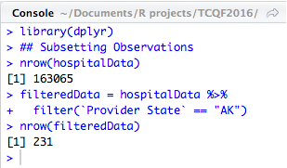
Subsetting Observations
Why do you need to subset? | dplyr verb
A column indicates the rows you need | filter()
You don’t want duplicates | distinct()
You only need a sample of the data | sample_frac() or sample_n()
You only need specific rows | slice()

Slide 21
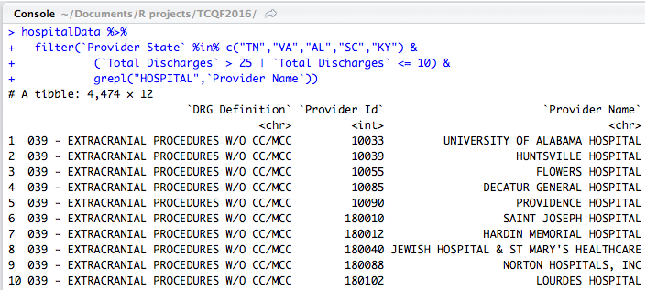
Subsetting Observations
filter()
First argument is the data frame to be subset
If using pipes, ignore this
Second argument is a single logical evaluation which references column names
To test for equality use ==
To compare relative values, >, <. >=, <=
To test for ’a’ AND ‘b’ use &
To test for ‘a’ OR ‘b’ use |
Parenthesis can nest arguments
Anything which returns a logical value in R can be used here
Column names with spaces need to be surrounded by `

Slide 22
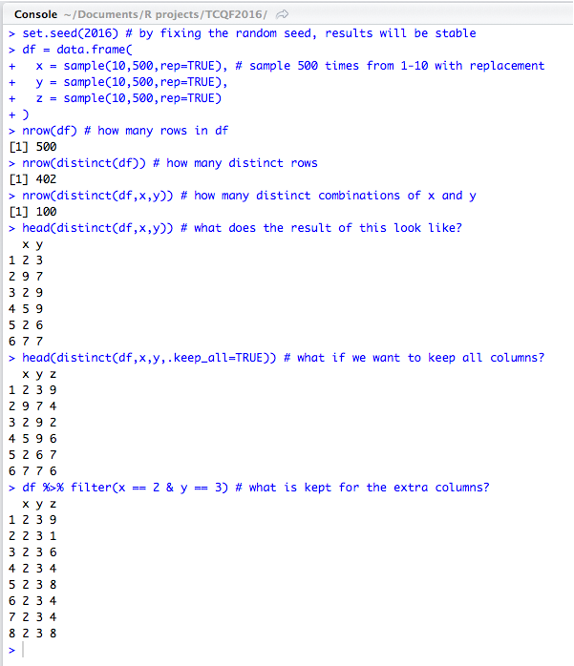
Subsetting Observations
distinct()
First argument is the data frame to be subset
If using pipes, ignore this
You can specify the columns to use for determining distinctness
This will only return those columns
Use .keep_all = TRUE to keep all columns
This will only keep the first row of each distinct combination

Slide 23
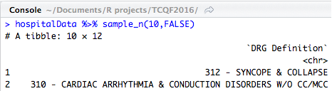
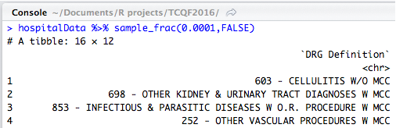
Subsetting Observations
sample_n() and sample_frac()
First argument is the data frame to be subset
If using pipes, ignore this
Second argument is the appropriate size
Integer if sample_n()
Decimal between 0 and 1 if sample_frac()
Third argument is if you want to sample with replacement (TRUE/FALSE)

Slide 24
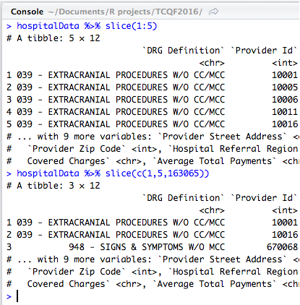
Subsetting Observations
slice()
First argument is the data frame to be subset
If using pipes, ignore this
Second argument is a vector of the rows to keep
This is based on the current ordering of data

Slide 25
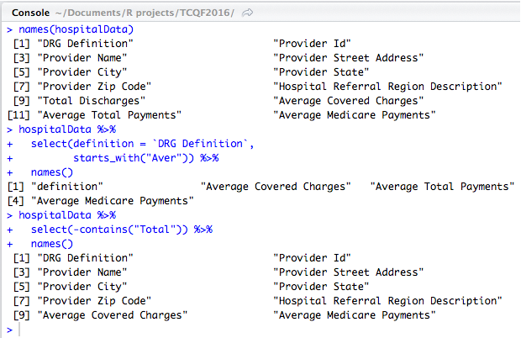
Subsetting variables
select()
First argument is a data frame – ignore if using pipes
Comma separated list of columns to keep or drop
You can only keep or drop in a single select statement
You can rename columns
newName = `Old name`
Special functions to get groups of columns
starts_with / ends_with
contains
everything
Column names containing spaces need to be wrapped with `

Slide 26
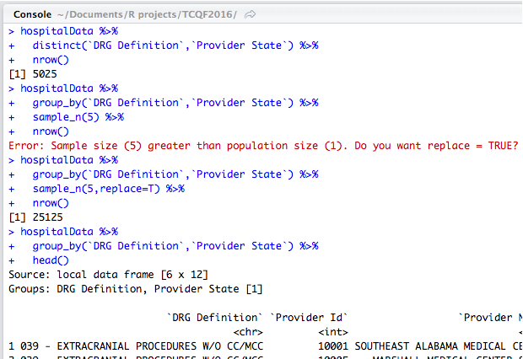
Grouping Data
group_by()
First argument is a data frame – ignore if using pipes
Comma separated list of columns to group by
Order implies hierarchy
Column names containing spaces need to be wrapped with `
IMPORTANT! Most dplyr functions evaluate with respect to grouping
ungroup()
Removes all grouping information

Slide 27
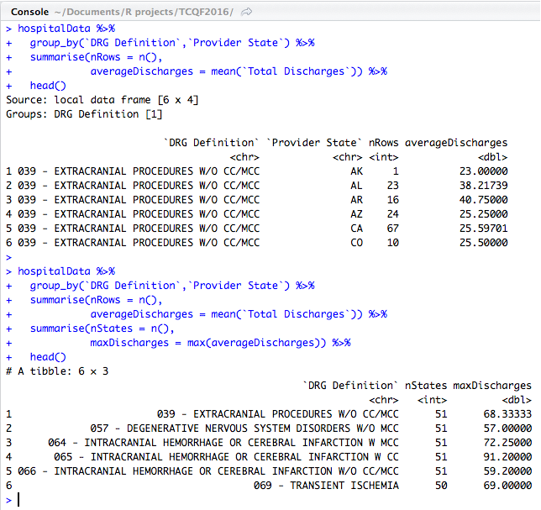
Summarizing Data
summarise() or summarize()
First argument is a data frame – ignore if using pipes
Comma separated list of summarizations to compute
summary = someOperation
Relies on group_by to be effective
After summarization is complete, the group_by hierarchy has it’s lowest level dropped

Slide 28
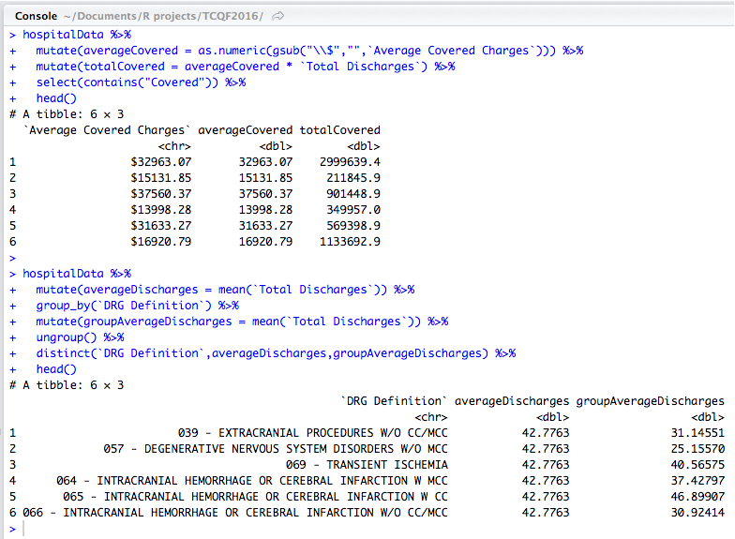
Making new variables
mutate()
First argument is a data frame – ignore if using pipes
Comma separated list of changes to make
newColumn = someOperation
While multiple mutations can be applied in single statement, they happen simultaneously so you cannot chain them together
Respects group_by()
Mutations work exactly as they do in base R

Slide 29
Combining data
Advanced Topic
Provides access to SQL-like joins
Left joins
Inner joins
Outer joins
Anti joins
Lots of examples online

Slide 30

tidyr
A grammar of data wrangling
Built around a set of ‘verbs’
spread()
gather()

Slide 31
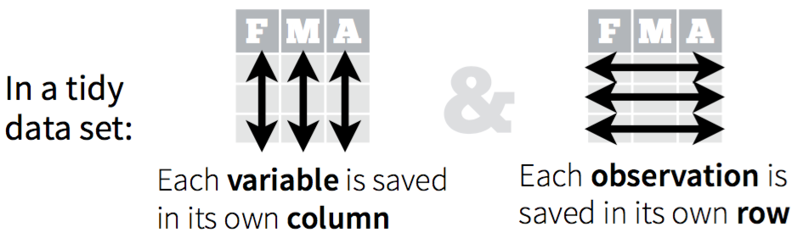
Tidy data
A dataset is said to be tidy if it satisfies the following conditions
observations are in rows
variables are in columns
contained in a single dataset.
Tidy data makes it easy to carry out data analysis.

Slide 32
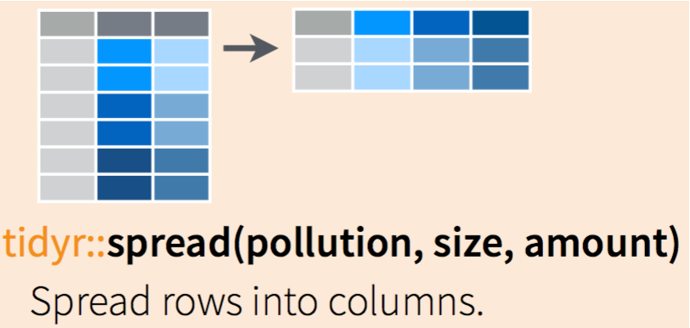
Pivot Data
spread()
First argument is a data frame – ignore if using pipes
Second argument is the column which contains values which need to be turned into columns
Third argument is the column which contains the values to populate the new columns
Optional argument ’fill’ allows you to specify what value to use when no value exists in the original data

Slide 33
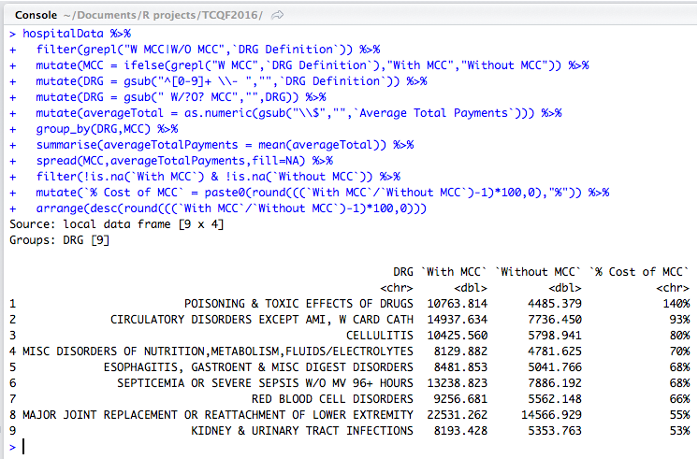
Pivot Data
Wanted to understand how the use of MCC affected cost of treatments
Did some filtering, mutating to get variables correct
Summarized the data
Spread allows the direct comparison of w/MCC and w/o MCC treatments

Slide 34
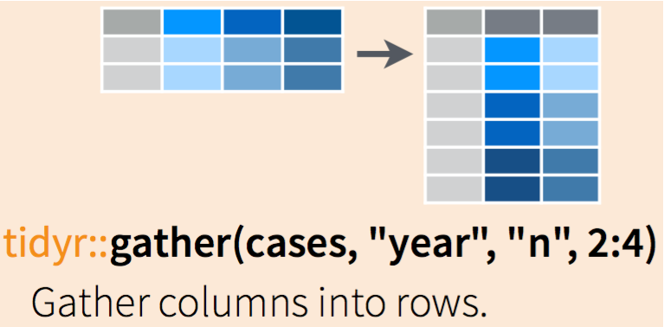
UnPivot Data
gather()
First argument is a data frame – ignore if using pipes
Second argument is the name of the new column which will contain all the existing column names
Third argument is the name of the new column which will contain the values
Fourth argument is which columns to gather

Slide 35
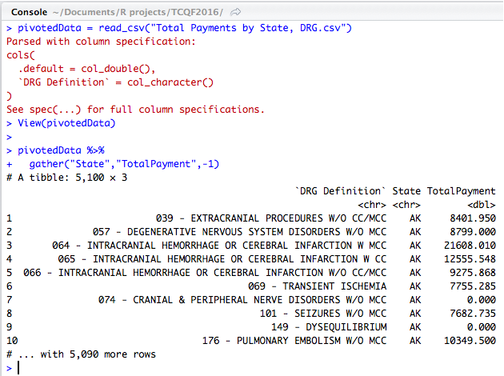
UnPivot Data
Pivoted data is typically summarized data, so there’s been a loss of detail
Pivoted data can be difficult to work with, especially from a modeling perspective
Unpivoting reduces the number of columns we need to work with and makes things like mutate easier to use

Slide 36
RMarkdown
Making making reports fast and easy

Slide 37
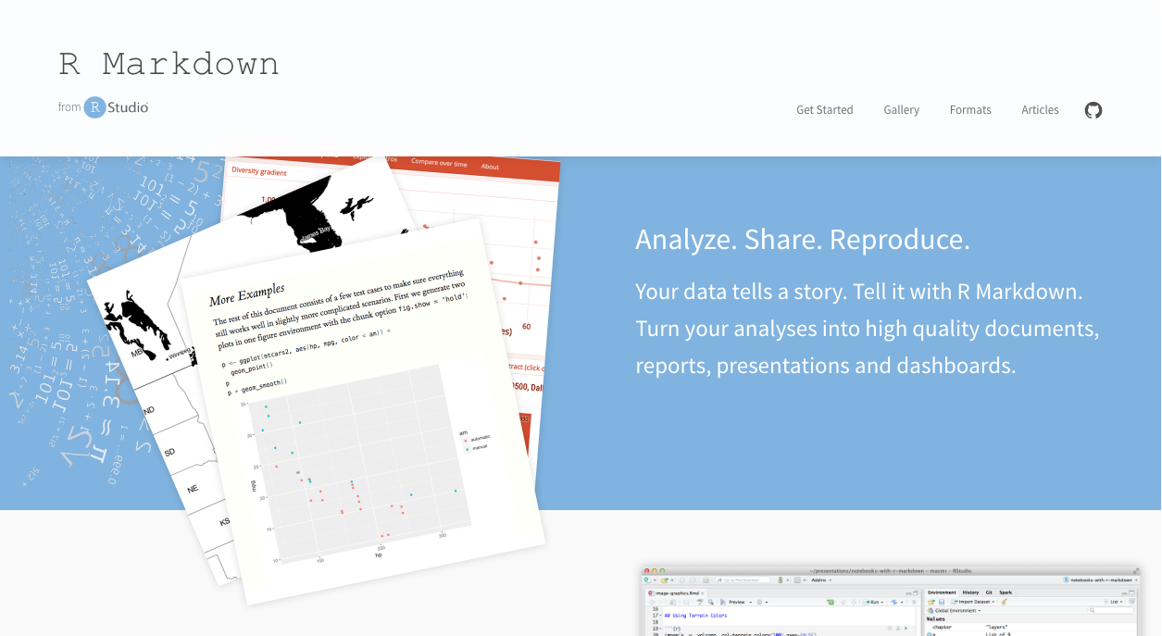
RMarkdown

Slide 38
Resources

Slide 39
Download R
https://cran.rstudio.com/
Download RStudio
https://www.rstudio.com/products/rstudio/
RStudio Webinars (additional learning)
https://www.rstudio.com/resources/webinars/
https://www.rstudio.com/resources/webinars/data-wrangling-with-r-and-rstudio/
https://www.rstudio.com/resources/webinars/reproducible-reporting/
Cheatsheets, example code and this presentation
https://github.com/bmewing/TCQF2016

